Slide 1
Pointers in C

Slide 2
Contents:
Introduction to C
Introduction to Pointers
Declaration and Initialization of Pointers
Types of pointers
Pointers and arrays
Pointers and strings
Pointer Arithmetic
Pointers to Pointer
Pointer Applications
Advantages and disadvantages of pointers
Conclusion

Slide 3
Introduction To C language:
C programming is a general-purpose, procedural, imperative computer programming language developed in 1972 by Dennis M. Ritchie at the Bell Telephone Laboratories to develop the UNIX operating system. C is the most widely used computer language.
Key advantages of learning C Programming:
Easy to learn
Structured language
It produces efficient programs
It can handle low-level activities
It can be compiled on a variety of computer platforms
Facts about C
C was invented to write an operating system called UNIX.
C is a successor of B language which was introduced around the early 1970s.
The language was formalized in 1988 by the American National Standard Institute (ANSI).
The UNIX OS was totally written in C.
Today C is the most widely used and popular System Programming Language.
Most of the state-of-the-art software have been implemented using C.

Slide 4
Introduction to Pointers:
What is a pointer?
Instead of storing a value, a pointer will store the address of a variable.
The Pointer in C, is a variable that stores address of another variable. A pointer can also be used to refer to another pointer function. A pointer can be incremented/decremented, i.e., to point to the next/ previous memory location. The purpose of pointer is to save memory space and achieve faster execution time.

Slide 5
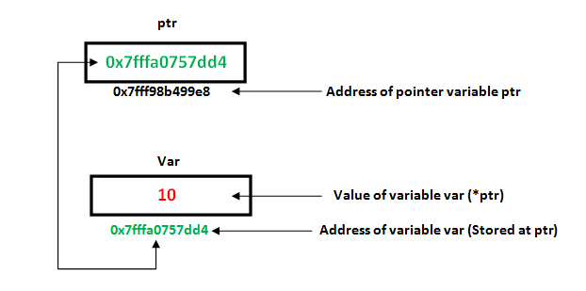
Declaration and Initialization of Pointers:
Like variables, pointers in C programming have to be declared before they can be used in your program. Pointers can be named anything you want as long as they obey C's naming rules. A pointer declaration has the following form.
data_type * pointer_variable_name;
Here,
data_type is the pointer's base type of C's variable types and indicates the type of the variable that the pointer points to.
The asterisk (*: the same asterisk used for multiplication) which is indirection operator, declares a pointer.
The process of assigning the address of a variable to a pointer variable is known as initialization. Once a pointer variable has been declared we can use the assignment operator to initialize the pointer variable.
For example, consider the code snippet below
int *p, a;
p=&a;
Here the address of the integer variable ‘a’ is stored in pointer variable ‘p’.
The ampersand operator (&) gives the address of the variable and *p gives the value stored at the address in the pointer variable.

Slide 6
C Program to demonstrate declaration and initialization of pointers:
#include<stdio.h>
main()
{
int a=20;
int *p;
p=&a;
printf(“Address of variable a= %d\n ”,p);
printf(“value of a= %d \n”, *p);
}

Slide 7
Direct and Indirect Access Pointers
Direct access: we use directly the variable name
Indirect access: we use a pointer to the variable
#include <stdio.h>
int var = 1; /* Declare and initialize an int variable */
int *ptr; /* Declare a pointer to int */
int main( void )
{
ptr = &var; /* Initialize ptr to point to var */
/* Access var value directly and indirectly */
printf("\nDirect access, var = %d", var);
printf("\nIndirect access, var = %d", *ptr);
/* Display the address of var in two ways */
printf("\n\nThe address of var = %d", &var);
printf("\nThe address of var = %d\n", ptr);
*ptr=48; /*change the content of var through the pointer*/
printf("\nIndirect access, var = %d", *ptr);
}

Slide 8
Types of Pointers:
Null Pointer:
We can create a null pointer by assigning null value during the pointer declaration. This method is useful when you do not have any address assigned to the pointer. A null pointer always contains value 0.
Void Pointer:
A void pointer is also called as a generic pointer. It does not have any standard data type. A void pointer is created by using the keyword void. It can be used to store an address of any variable.
Wild pointer:
A pointer is said to be a wild pointer if it is not being initialized to anything. These types of C pointers are not efficient because they may point to some unknown memory location which may cause problems in our program and it may lead to crashing of the program. One should always be careful while working with wild pointers.
Other types of pointers are:
Dangling pointer 4. Far pointer
Complex pointer 5. Huge pointer
Near pointer

Slide 9
Pointers & Arrays with Examples
Traditionally, we access the array elements using its index, but this method can be eliminated by using pointers. Pointers make it easy to access each array element.
#include <stdio.h>
int main()
{
int a[5]={1,2,3,4,5}; //array initialization
int *p; //pointer declaration
p=a; /*the ptr points to the first element of the array. We can also type simply ptr==&a[0] */
printf("Printing the array elements using pointer\n");
for(int i=0;i<5;i++) //loop for traversing array elements
{
printf("\t%x",*p); //printing array elements
p++; //incrementing to the next element, you can also write p=p+1
}
}
Output: 1 2 3 4 5.

Slide 10
Pointers and Strings with Examples
A string is an array of char objects, ending with a null character '\ 0'. We can manipulate strings using pointers. This pointer in C example explains this section
main()
{
char str[]="Hello Humans!";
char *p;
p=str;
printf("First character is:%c\n",*p);
p =p+1;
printf("Next character is:%c\n",*p);
printf("Printing all the characters in a string\n");
p=str; //reset the pointer
for(int i=0;i<strlen(str);i++)
printf("%c\n",*p);
p++;
}
Output:
First character is: H
Next character is: e
Printing all the characters in a string:
H
e
l
l
o
H
u
m
a
n
s

Slide 11
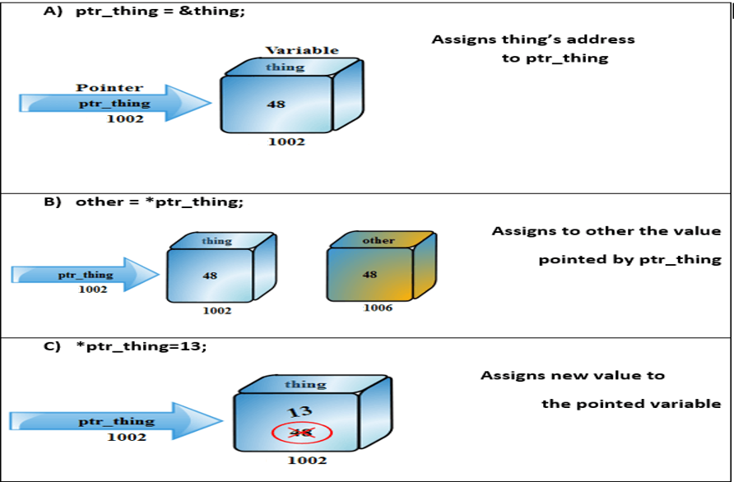
Pointer Arithmetic's in C

Slide 12
Pointer Increment and Decrement:
C Program to demonstrate pointer arithmetic:
#include <stdio.h>
int main()
{
int N = 4;
int *ptr1, *ptr2;
ptr1 = &N;
ptr2 = &N;
printf("Pointer ptr1 before Increment: %d \n", ptr1);
ptr1++;
printf("Pointer ptr1 after Increment: %d \n", ptr1);
printf("Pointer ptr1 before Decrement: %d \n", ptr1);
ptr1--;
printf("Pointer ptr1 after Decrement: %d \n", ptr1);
return 0;
}
Increment: It is a condition that also comes under addition. When a pointer is incremented, it actually increments by the number equal to the size of the data type for which it is a pointer.
Decrement: It is a condition that also comes under subtraction. When a pointer is decremented, it actually decrements by the number equal to the size of the data type for which it is a pointer.

Slide 13
Priority operation (precedence)
When working with C pointers, we must observe the following priority rules:
1)The operators * and & have the same priority as the unary operators (the negation!, the incrementation++, decrement--).
2) In the same expression, the unary operators *, &,!, ++, - are evaluated from right to left.
If a P pointer points to an X variable, then * P can be used wherever X can be written.
The following expressions are equivalent:
int X =10
int *P = &Y;
For the above code, below expressions are true
Expression Equivalent Expression
Y=*P+1 Y=X+1
*P=*P+10 X=X+10
*P+=2 X+=2
++*P ++X
(*P)++ X++
In the latter case, parentheses are needed: as the unary operators * and ++ are evaluated from right to left, without the parentheses the pointer P would be incremented, not the object on which P points.

Slide 14
A C program to deal with an pointer character array:
#include <stdio.h>
int main()
{
int i ;
char *materials[ ] = { "iron", "copper", "gold"};
printf("Please remember these materials :\n");
for (i = 0; i < 3; i++)
{
printf("%s\n", materials[ i ]);
}
}
Output:
Please remember these materials:
iron
copper
gold

Slide 15
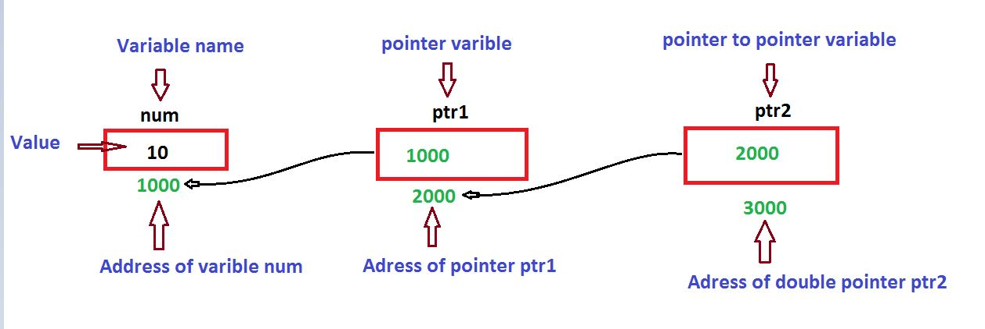
Pointer to Pointer:
A program to demonstrate pointer to pointer:
int main(){
int x=5;
int*p;
p=&x;
printf("%d\n",p);
printf("%d\n",*p);
int **q;
q=&p;
printf("%d\n",q);
printf("%d\n",*q);
int ***r;
r=&q;
printf("%d\n",r);
printf("%d\n",***r)
}
A pointer to a pointer is a form of multiple indirection, or a chain of pointers.
When we define a pointer to a pointer, the first pointer contains the address of the second pointer, which points to the location that contains the actual value as shown below.

Slide 16
Applications of pointers:
1) To modify variable of function in other function.
//C program to demonstrate that we can change local values of one function in another using pointers.
void swap(int* x, int* y){
int temp = *x;
*x = *y;
*y = temp;}
int main(){
int x = 10, y = 20;
swap(&x, &y);
printf("%d %d\n", x, y);}
Output : 20 10
2) For accessing array elements. Compiler internally uses pointers to access array elements.
// C program to demonstrate that compiler internally uses pointer arithmetic to access array elements.
int main()
{
int arr[ ] = { 100, 200, 300, 400 };
// Compiler converts below to *(arr + 2).
printf("%d ", arr[2]);
// So below also works.
printf("%d\n", *(arr + 2));
}
Output :
300
300

Slide 17
3)To return multiple values.
int main()
{
int n = 100;
int sq;
double sq_root;
fun(n, &sq, &sq_root);
printf("%d %f\n", sq, sq_root);
return 0;
}
int fun(int n, int* sq, double* sq_root)
{
*sq = n * n;
*sq_root = sqrt(n);
return(*sq);
return(*sq_root);
}
Output : 10000
10
4) For efficiency purpose.
Example passing large structure without
reference would create a copy of the structure
(hence wastage of space).
5)Dynamic memory allocation :
We can use pointers to dynamically allocate
memory. The advantage of dynamically
allocated memory is, it is not deleted until we
explicitly delete it
6)To implement data structures.
Example linked list, tree, etc.
7)To do system level programming where
memory addresses are useful.
For example shared memory used by multiple
threads.

Slide 18
Advantages of Pointers in C
Disadvantages of Pointers in C
Pointers are useful for accessing memory locations.
Pointers provide an efficient way for accessing the elements of an array structure.
Pointers are used for dynamic memory allocation as well as deallocation.
Pointers are used to form complex data structures such as linked list, graph, tree, etc.
Pointers can lead to various errors such as segmentation faults or can access a memory location which is not required at all.
If an incorrect value is provided to a pointer, it may cause memory corruption.
Pointers are also responsible for memory leakage.
Pointers are comparatively slower than that of the variables.
Programmers find it very difficult to work with the pointers; therefore it is programmer's responsibility to manipulate a pointer carefully.

Slide 19
Conclusion:
Even though pointers seems like a hard concept to understand (and also seems pretty much useless for us), it is in reality a pretty interesting concept which is definitely very important and useful for anyone who aspires to be a programmer or work in the IT field. Pointers are implemented in all the major software's used in health care industry, aviation industry, major social media apps we use on a daily bases, etc. Without pointers it would almost be seemingly impossible for most of the our modern software and tech to function.

